Slide 1
Portfolio Development

Slide 2
LOAN STATISTICS

Slide 3
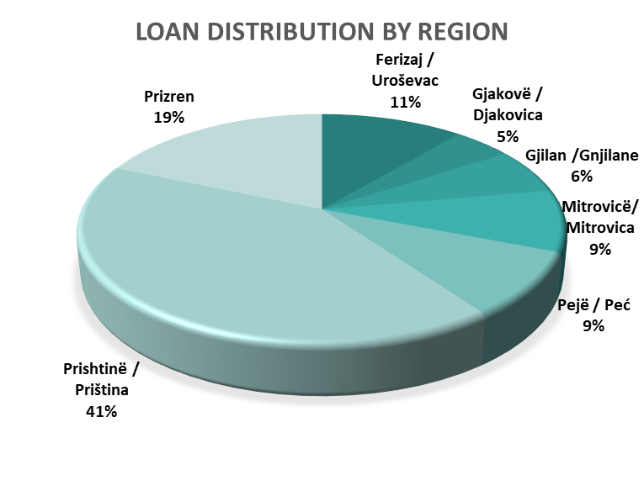
LOAN DISTRIBUTION BY REGION

Slide 4
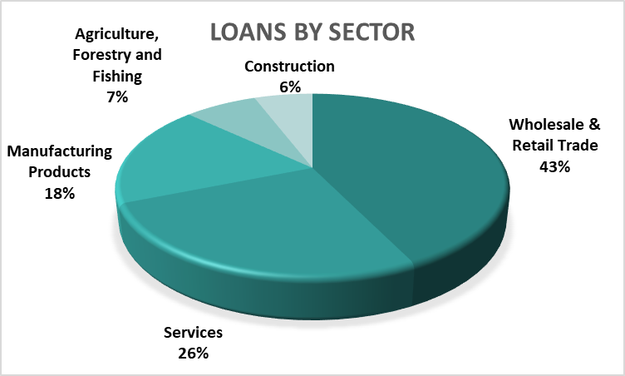
LOANS BY SECTORS

Slide 5
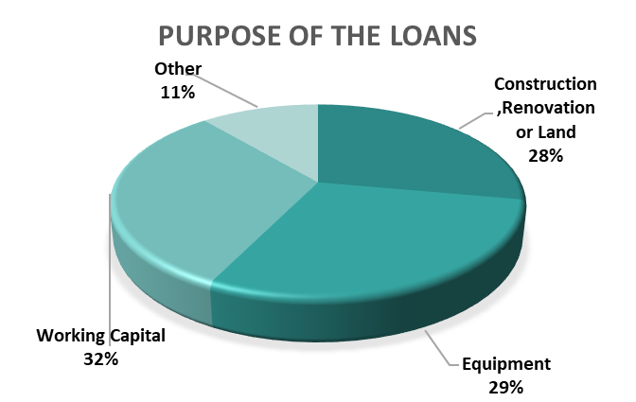
LOAN PURPOSE

